Slide 1
Employee Salary Analysis using Excel
STUDENT NAME : Jothika.S
REGISTER NO : 312208494
DEPARTMENT : B.com (commerce)
COLLEGE : Chellammal women's college

Slide 2

Employee Salary Analysis

Slide 3
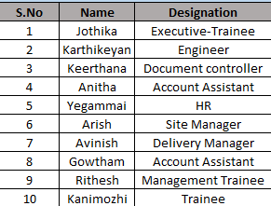
Entry of employee details:

Slide 4

Calculation of Basic Salary:
Basic Salary = gross salary – allowances ( DA & HRA & PF )

Slide 5

Calculation of gross salary:
Gross salary = basic salary + dearness allowances + house rent allowances + Provident fund
Gross Salary =32500-(DA-2500)-(HRA-2000)-PF(3000)=25000

Slide 6

Calculation of EPF & UC amount:
EPF – off amount of Employee provident fund
EPF = PF/2

Slide 7

Calculation of Deduction from:
Deduction = EPF + UC ( Off of EPF)

Slide 8

Calculation of Net Profit:
Net profit : Gross Salary (basic pay + DA + HRA + PF) – Deduction ( EPF + UC)

Slide 9
THANK YOU ….

